Slide 1

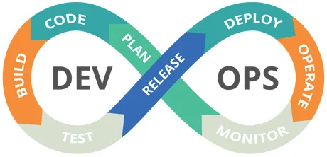

23sdcs13A/R
CI/CD and Cloud devops
Topic:
Containerize react project
Dr. suneetha Bulla

Slide 2
Dockerfile
A Dockerfile is a text-based document that's used to create a container image.
It provides instructions to the image builder on the commands to run, files to copy, startup command, and more.

Slide 3
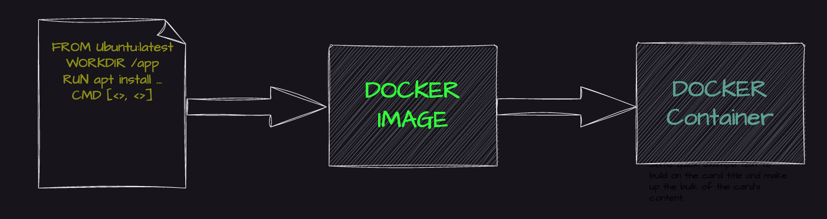
Dockerefile (Cont..)

Slide 4
Key Components of a Dockerfile:
Base Image: The starting point for your Docker image. For example, if you're building a Python application, you might start with python:3.9 as your base image.
Application Code and Dependencies: The code is added to the image, and dependencies are installed to ensure the application runs correctly.
Commands and Configurations: Instructions to execute commands, set environment variables, and expose ports.

Slide 5
Basics Syntax of a Dockerfile
A Dockerfile contains simple instructions, where each instruction performs a specific action.
Instructions like FROM, COPY, RUN, and CMD are case-sensitive and written in uppercase.
Each instruction creates a new layer in the Docker image.
FROM ubuntu:20.04
COPY . /app
RUN apt-get update && apt-get install -y python3
CMD ["python3", "/app/app.py"]

Slide 6
FROM python:3.9
  Specifies the base image for your build.
  A Dockerfile must start with a FROM instruction, except in multi-stage builds.
FROM
COPY . /app
  Copies files or directories from the host system into the container
COPY
RUN apt-get update && apt-get install -y curl
  Executes commands during the build process. Often used to install packages
RUN

Slide 7
CMD ["python3", "app.py"]
  Specifies the default command to run when the container starts.
CMD
WORKDIR /usr/src/app
  Sets the working directory inside the container.
WORKDIR
EXPOSE 8080
  Documents the port the container listens on.
EXPOSE

Slide 8
Create Docker file to containerize the react project

Slide 9
DockerFile
FROM node:20
WORKDIR /app
COPY package*.json ./
RUN npm install
COPY . .
EXPOSE 5173
CMD ["npm", "run", "dev"]

Slide 10
Dockerfile Running Commands
docker build -t my-firstapp .
docker run -p 5173:5173 my-firstapp
docker run -p 5173:5173 my-firstapp npm run dev -- --host

Slide 11
Multi-Stage Dockerfile
Multi-stage builds allow you to create lean production images by separating the build and runtime environments.
  Stage 1 (Builder/Development): Install dependencies, compile code, and build the application.
  Stage 2 (Production): Copy only the necessary files from the build stage.

Slide 12
Distroless Images
Distroless images are minimalistic and purpose-built, containing only the essential components to run an application. This approach significantly reduces the attack surface and minimizes the image size, enhancing security and efficiency.
Smaller Image Size: Distroless images exclude unnecessary components, resulting in smaller images.
Enhanced Security: By minimizing the attack surface, distroless images improve security.

Slide 13
# Stage 1: Build the application
FROM node:16 AS builder
WORKDIR /app
COPY package.json .
RUN npm install
COPY . .
RUN npm run build
# Stage 2: Run the application
FROM nginx:alpine
COPY --from=builder /app/build /usr/share/nginx/html
EXPOSE 80
CMD ["nginx", "-g", "daemon off;"]

Slide 14
Create Single-Stage Dockerfile to containerize the react project

